Slide 1
Expression data from infant nasal airway epithelial cells treated with IFN-lamda,poly(1:c),or both
1-منار عبد الحافظ محمود عبد الحافظ.
2-منار احمد محمد محمود.
3-منار ماهر فتح الله محمد.
4-مروة محمود سيد عبد الحليم.
Idea number 2
Prof. Dr. Taysir Hassan A.Soliman

Slide 2
Outline
1-T-test for my analysis.
.2-Visualize my results using boxplots
.3-Visualize my results using histograms
4-Visualize my results using plot with function paired()between two groups(treat,untreat)
5-Using function summarise().
Results of the analysis
Describe datasets in detail(number of attributes , number of records ,data resources)
R code that used for analysis

Slide 3
Describe dataset in detail
Link: https://www.ncbi.nlm.nih.gov/geo/query/acc.cgi?acc=GSE153428
Organism: Homo sapiens.
Experiment type: Expression profiling by array.
Summary: Type III interferon, also known as interferon lambda (IFN-λ), is the newest addition to the IFN family. IFN-λ is primarily produced by the airway epithelium and curbs viral infections without triggering systemic pro-inflammatory cytokine responses1. Of the current IFN COVID-19 trials (as of 6/27/2020), four propose the use of IFN-λ. However, it remains to be determined whether IFN-λ induces ACE2 expression in the human airway epithelium.. Of the current IFN COVID-19 trials (as of 6/27/2020), four propose the use of IFN-λ. However, it remains to be determined whether IFN-λ induces ACE2 expression in the human airway epithelium.
Overall design: Using primary human nasal airway epithelium of young children, we employed RNA extraction and hybridization on Affymetrix microarrays to examine for the first time the effects of IFN-λ and a viral mimic (poly I:C) on the expression of ACE2 and the global antiviral transcriptomic program.
Number of attributes: 12 samples.
Number of records: 20 gene.

Slide 4
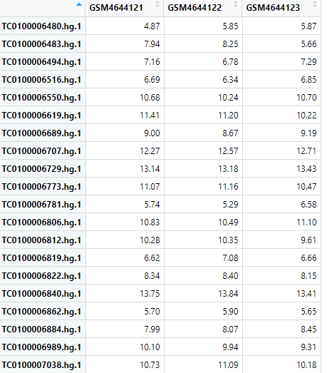
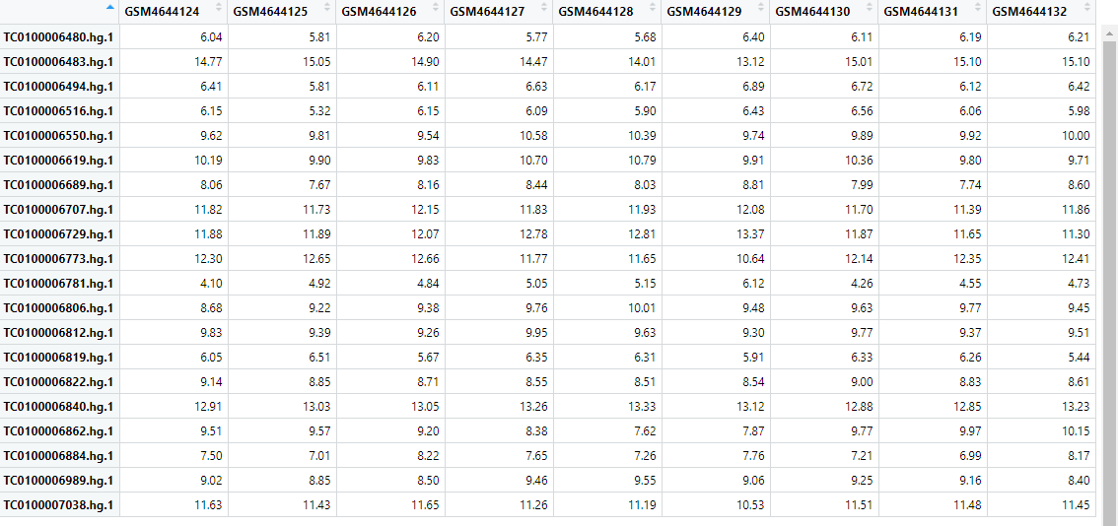
Group2_untreated Group1_treated

Slide 5
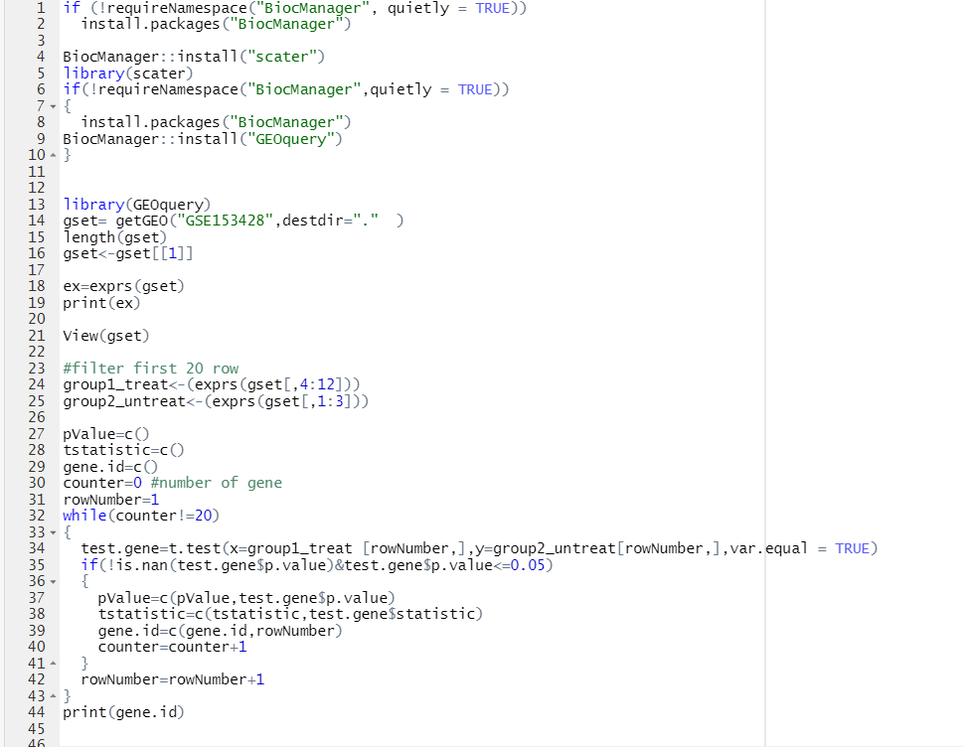
R code used for analysis

Slide 6
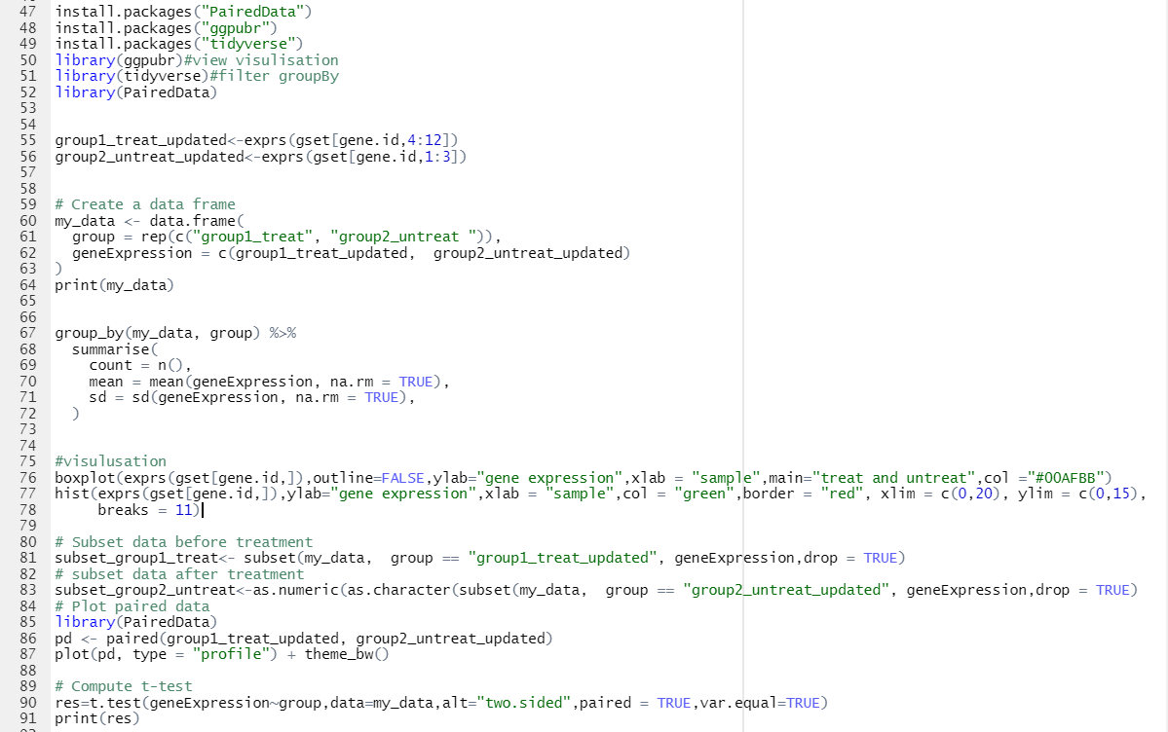

Slide 7
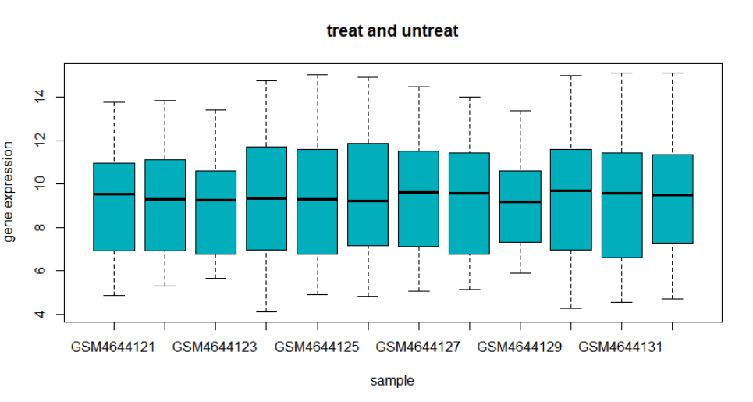
Visualize my results using boxplots

Slide 8
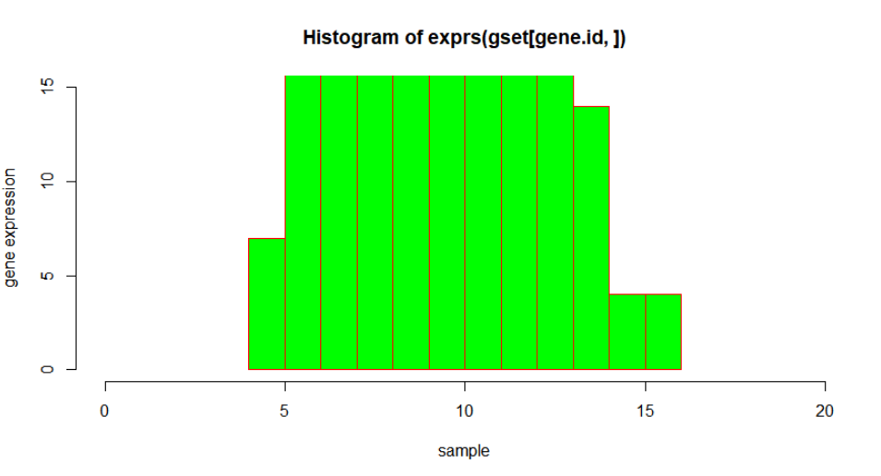
Visualize my results using histograms

Slide 9
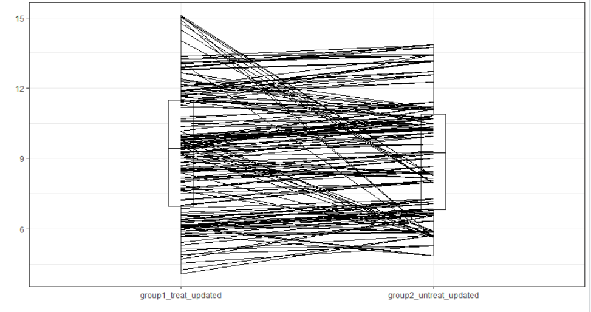
4-Visualize my results using plot with two function paired()between groups(treat ,untreat)

Slide 10
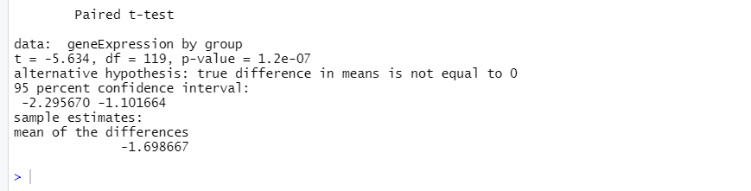
Output T-test

Slide 11
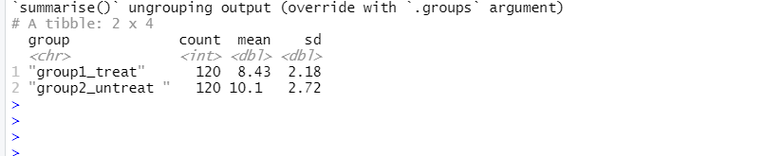
Output function summarise()

